Slide 1
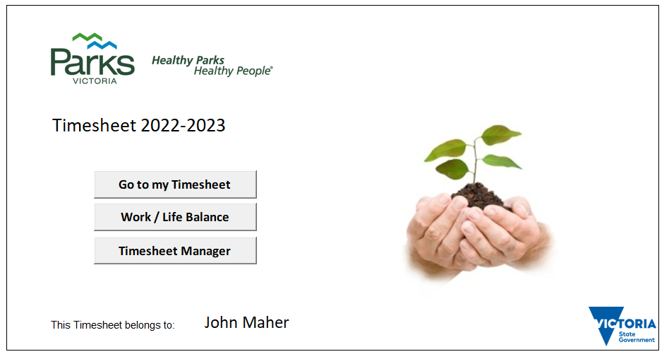
Parks Victoria Timesheet 2022-23

Slide 2
Parks Victoria Timesheet 2022-23
Purpose:
1. To assist in the management of Fatigue and compliance including Rostered Days Off
2. To enable Parks Victoria to determine where when and how much work is done on PV Programs
Considerations:
The user interface must be easy to setup, intuitive, quick and easy to use.

Slide 3
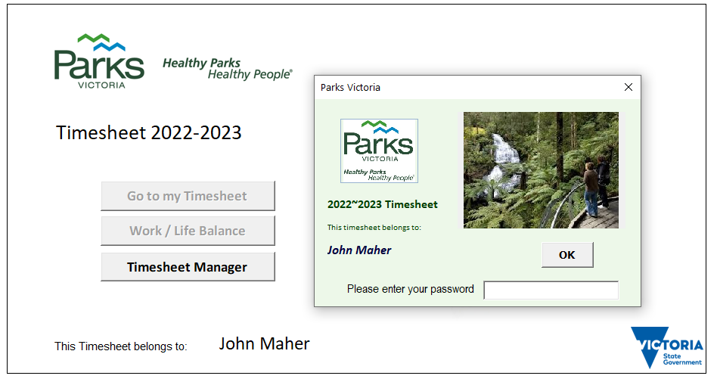
Parks Victoria Timesheet 2022-23
The new timesheet includes password protection so only the owner can view and change information.
Navigation buttons are disabled until the correct password is entered
The Timesheet Manager button is always enabled for administrator access

Slide 4
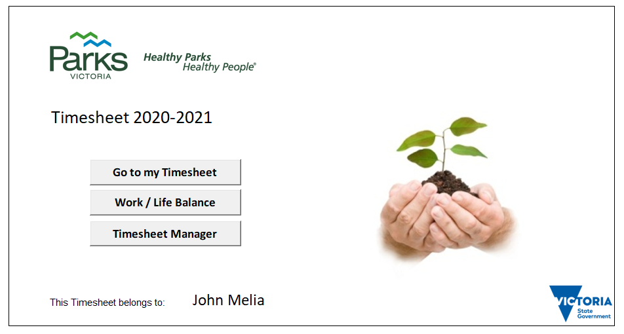
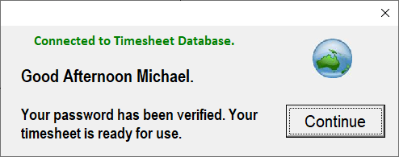
Parks Victoria Timesheet 2022-23
After you have entered your password, your timesheet is ready for use.

Slide 5
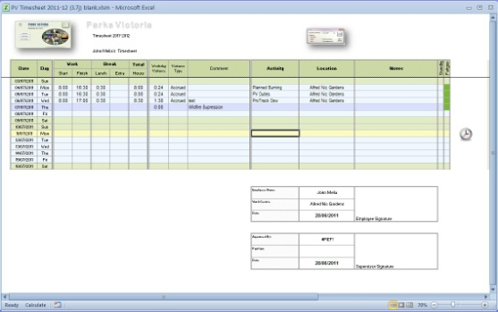
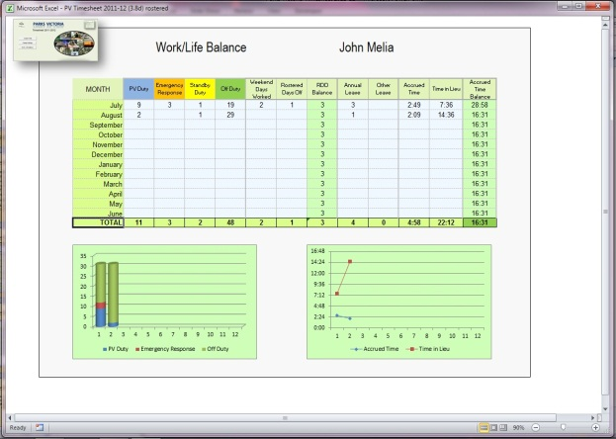
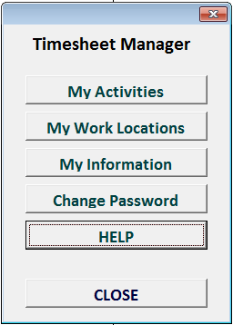
Parks Victoria Timesheet 2022-23
Timesheet page used to enter/update daily information
Work/Life Balance report page
Timesheet manager for setting up Activities,
Work Locations,
Personal Information,
Change Password &
Help

Slide 6
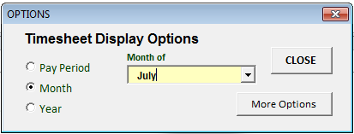
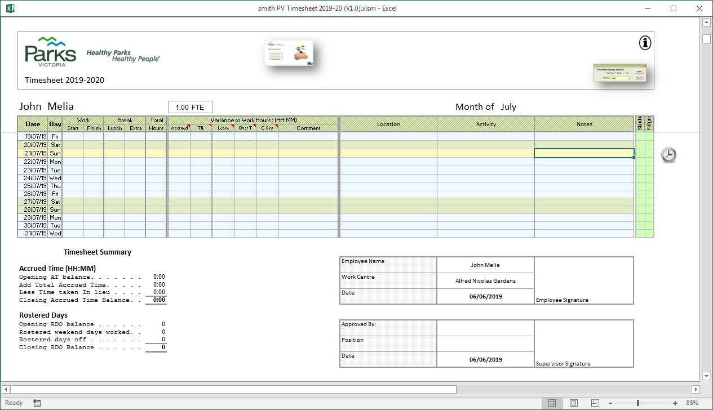

Parks Victoria Timesheet 2022-23
The Main menu Icon takes you back to the Main Navigation Page
The options Icon allows you to change the selected period and to view the timesheet in different ways e.g. by pay period,
by month or year.
There are also custom views e.g. weekend days, public holidays or by activity.
The update Icon (when visible) allows you to enter information for the selected day

Slide 7
Parks Victoria Timesheet 2022-23
Timesheet display options
Click the Options Icon to display the timesheet options form

Slide 8
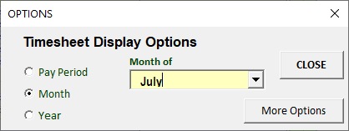
Parks Victoria Timesheet 2022-23
Timesheet display options
The Options form allows you to view your timesheet by pay period, month or year.

Slide 9
Parks Victoria Timesheet 2022-23
Timesheet display options
Click the More Options button to customise the timesheet view and print your timesheet

Slide 10
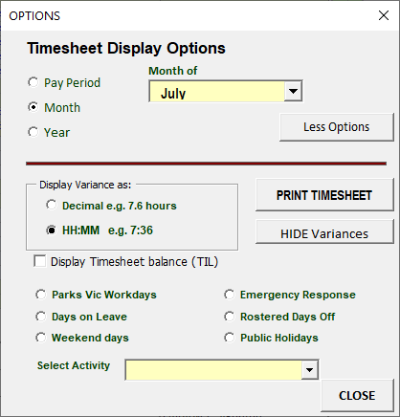
Parks Victoria Timesheet 2022-23
Timesheet display options
Print and email your timesheet.
Customise how your timesheet looks

Slide 11

Parks Victoria Timesheet 2022-23
Filling-in your timesheet
Click the Update Icon to display a choice of work / leave options for the selected day

Slide 12
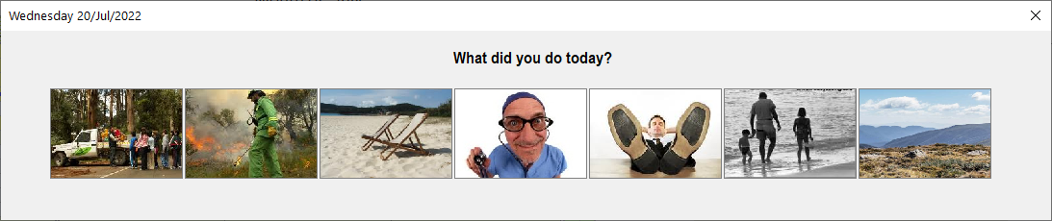
Parks Victoria Timesheet 2022-23
Filling-in your timesheet
Click on the image that describes ‘How you spent your day ‘

Slide 13
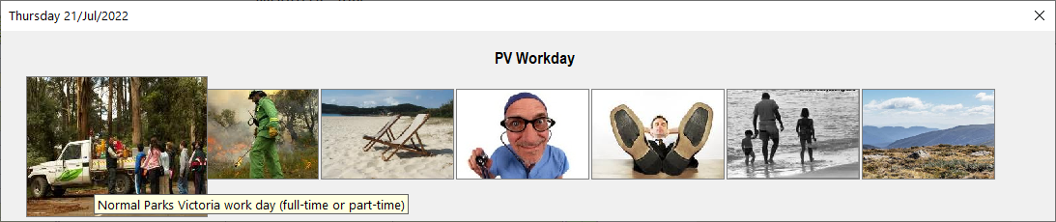
Parks Victoria Timesheet 2022-23
Filling-in your timesheet
When you move the mouse over the images, they ‘pop-out’ .
Click the mouse to select your option

Slide 14
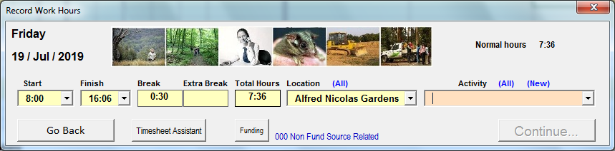
Parks Victoria Timesheet 2022-23
Filling-in your timesheet
When you click ‘PV Workday’, the ‘Record Work Hours’ form is presented.
This form can be setup to automatically populate your start time, finish time, break and work location, using the ‘Timesheet Assistant’ button,

Slide 15
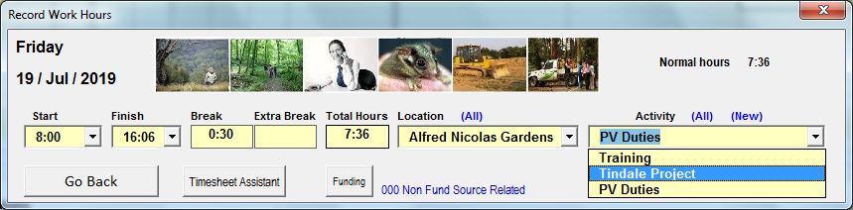


Parks Victoria Timesheet 2022-23
Filling-in your timesheet
If your Start and Finish times are correct, select your work Activity…

Slide 16
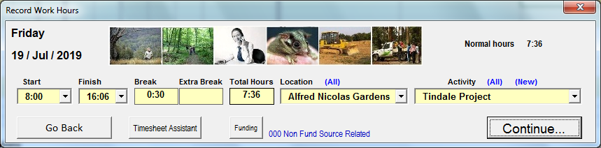
Parks Victoria Timesheet 2022-23
Filling-in your timesheet
….then click ‘Continue’ to finish your timesheet entry

Slide 17
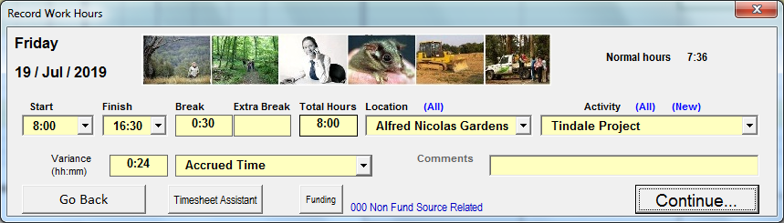

Parks Victoria Timesheet 2022-23
Filling-in your timesheet
If your worked hours are different than normal, select the correct time from the drop-down lists
You can change your Start time, Finish time and extra break time from drop lists or by typing into the box.

Slide 18
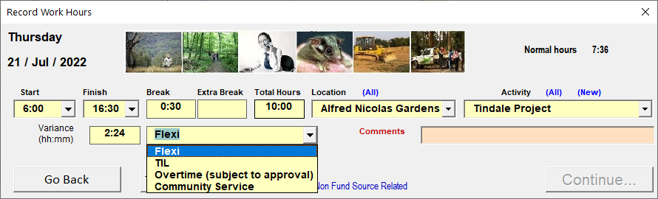
Parks Victoria Timesheet 2022-23
Filling-in your timesheet
Choose the correct variance type from the drop-down list.

Slide 19
Parks Victoria Timesheet 2022-23
Filling-in your timesheet
Flexitime may include:
Having an RDO option: Working an additional 24min per day makes an employee eligible for 1 day off per month.
Flexible working arrangements: These must balance within a short time frame and provide the flexibility to manage the necessary unpredictability of life. Typically, you would not expect this to be more than +/- 15min per day.
Condensed working weeks: The users work schedule looks standard, and employees are (mostly) consistent in which afternoon/day they take off. This would look like 1+ hours of additional work per day.

Slide 20
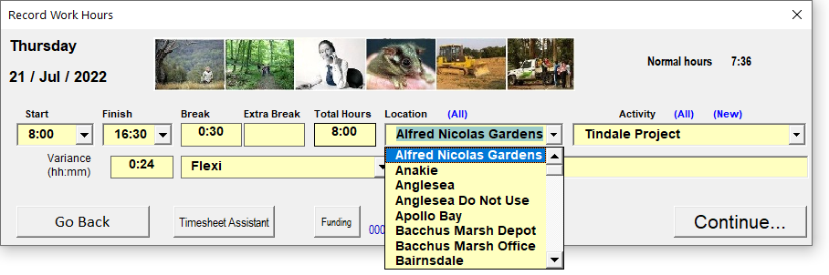
Parks Victoria Timesheet 2022-23
Filling-in your timesheet
If your work location changed for the day, you can select the correct location from your work location list

Slide 21
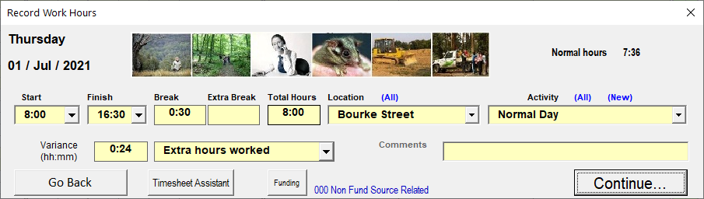
Parks Victoria Timesheet 2022-23
Filling-in your timesheet
When you are sure the times, location and activity is correct, click ‘Continue’ to save your information

Slide 22
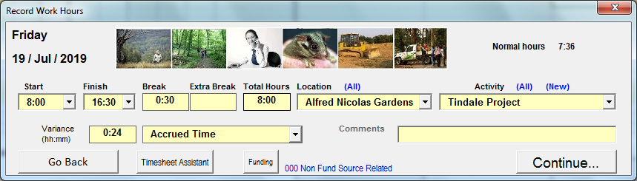
Parks Victoria Timesheet 2022-23
Filling-in your timesheet
Click the ‘Timesheet Assistant’ button to setup regular timesheet information

Slide 23
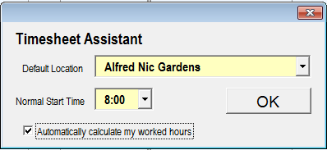
Parks Victoria Timesheet 2022-23
Filling-in your timesheet
Select your normal work location and start
Check the Auto Calculate box for the timesheet to automatically calculate your finish time and break.

Slide 24

Parks Victoria Timesheet 2022-23
Filling-in your timesheet
If your work location is not on your location list, click (All) to see a list of all PV locations

Slide 25
Parks Victoria Timesheet 2022-23
Filling-in your timesheet
You can also see all activities (Open & Closed) by clicking (All) Activities…

Slide 26
Parks Victoria Timesheet 2022-23
Filling-in your timesheet
…and if you have worked on a new activity. Click (New) to create a new activity

Slide 27
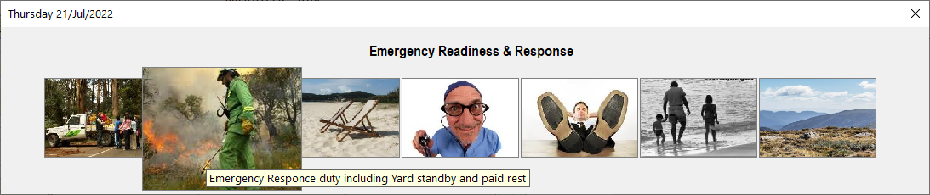
Parks Victoria Timesheet 2022-23
Emergency Readiness & Response
Click to record Emergency Readiness & Response duty

Slide 28
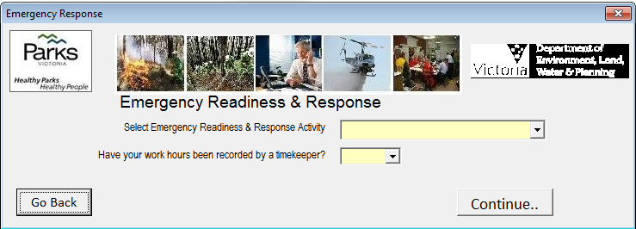
Parks Victoria Timesheet 2022-23
Emergency Readiness & Response
The Emergency Readiness & Response form opens

Slide 29
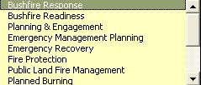
Parks Victoria Timesheet 2022-23
Emergency Readiness & Response
Select the type of duty performed from the drop list…

Slide 30


Parks Victoria Timesheet 2022-23
Emergency Readiness & Response
…then select if your work hours have been recorded by a timekeeper.

Slide 31

Parks Victoria Timesheet 2022-23
Emergency Readiness & Response
If your work hours have been recorded by a timekeeper, click continue to complete your timesheet.
If your work hours have NOT been recorded by a timekeeper, click Continue.. And you will be able to record your work hours on your timesheet.

Slide 32
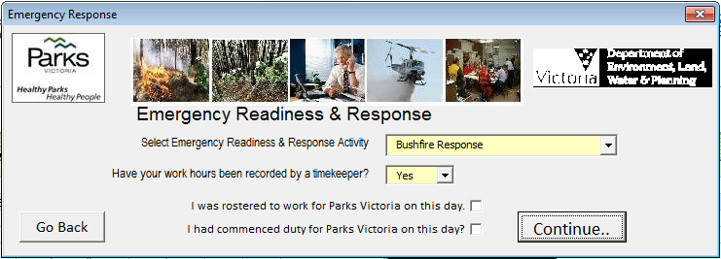

Parks Victoria Timesheet 2022-23
Emergency Readiness & Response
If you are a rostered employee working on a weekend day, you will see two extra check boxes
If you were rostered to work for Parks Victoria on the day, check the first box.
If you had commenced normal Parks duties on the day check the second box.

Slide 33
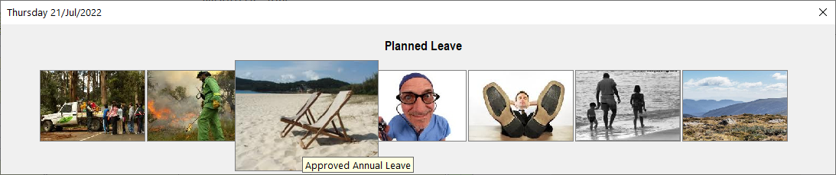
Parks Victoria Timesheet 2022-23
Planned Leave
Click the Planned Leave image to record planned leave on your timesheet.
Planned Leave is leave planned in advance e.g. annual leave, long service leave, maternity leave etc..

Slide 34
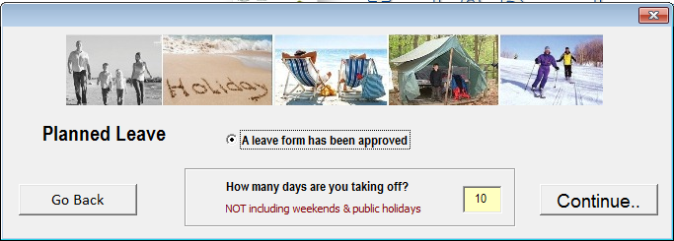
Parks Victoria Timesheet 2022-23
Planned Leave
If your supervisor has approved your leave in FAP, you must check “A leave form has been approved” …
…. then enter the number of days leave that has been approved.
Click “Continue” to complete your timesheet.

Slide 35
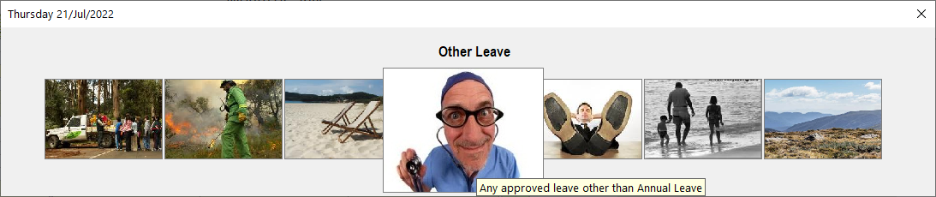
Parks Victoria Timesheet 2022-23
Other Leave
Click the ‘Other Leave’ image to record leave other than Planned leave on your timesheet.

Slide 36
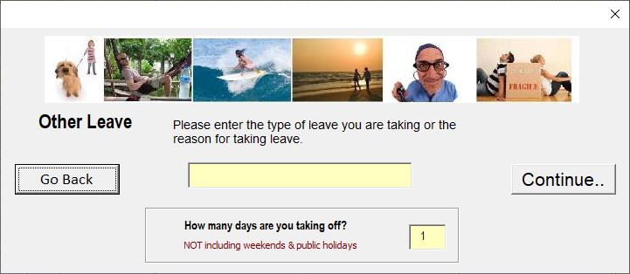
Parks Victoria Timesheet 2022-23
Other Leave
The ‘Other Leave’ form is displayed.
Enter your leave type or reason for taking leave then click “Continue”

Slide 37
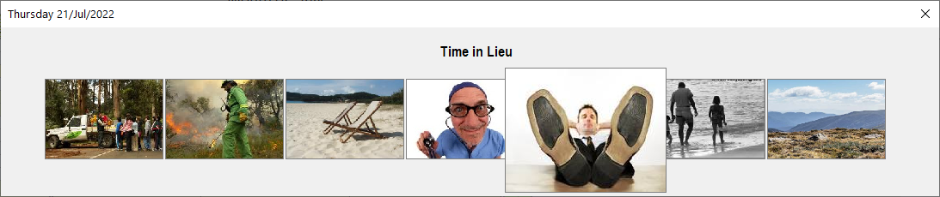
Parks Victoria Timesheet 2022-23
Day off as Time in Lieu (TIL)
Click “Time in Lieu” to record a day off as TIL.
Your TIL day will be recorded on your timesheet

Slide 38
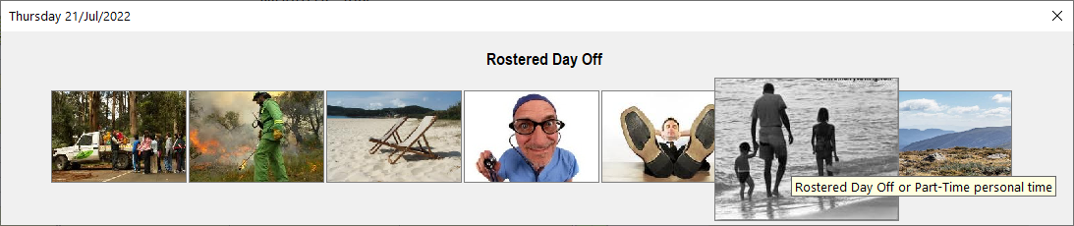
Parks Victoria Timesheet 2022-23
Rostered Day Off – Personal Time – Weekend Day Off – Public Holiday
Click ‘Rostered Days Off’ to record an RDO on your timesheet.
NOTE. Only available options will be displayed.
E.g. If you have no Rostered Days Off available, the option will not be visible.

Slide 39
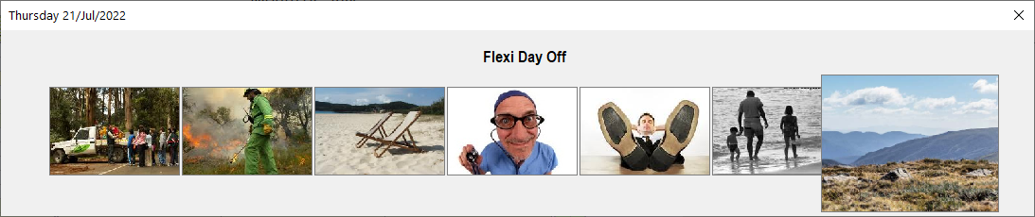
Parks Victoria Timesheet 2022-23
Day off as Time in Lieu (TIL)
Click “Flexi day off” to record a day off as flexitime.
Your flexi day will be recorded on your timesheet

